Slide 1



fullstackdatascience.com
Lesson 15 - Python for EDA
Python
Created by Huydata
DA K6
Lesson 3
huynt@fullstackdatascience.com
1

Slide 2

Learn
About
01/
EDA
02/
API and Load data to Bigquery
fullstackdatascience.com
2

Slide 3
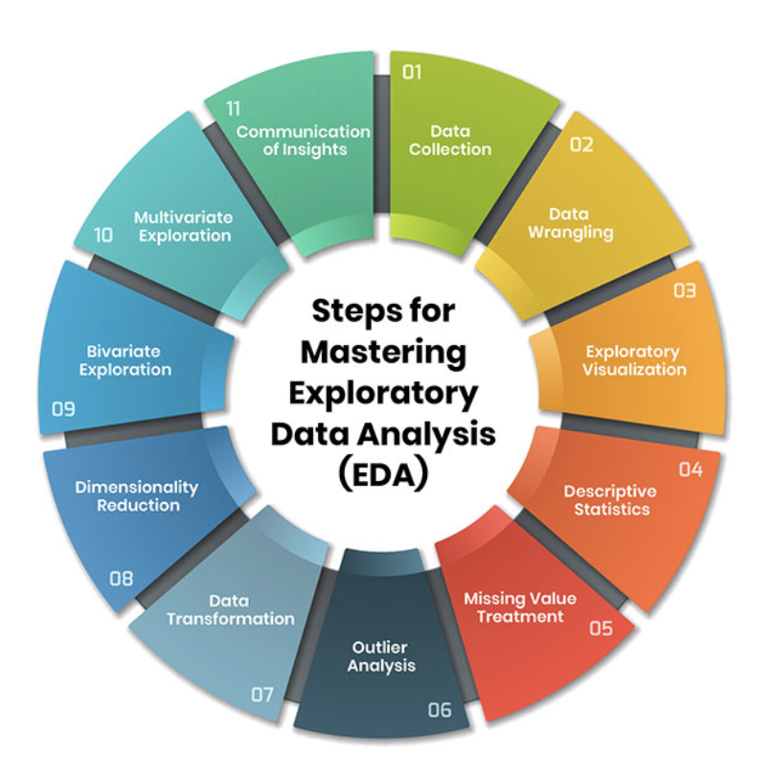
EDA
EDA – exploratory data analysis is the process of describing data using statistical and visualization techniques to focus on important aspects of the data for further analysis.
3

Slide 4
EDA (Exploratory Data Analysis) Implementation Process
Step 0. Problem Understanding & Analytical Questions
Step 1
Step 2
Step 3
Step 4
Data Overview - Loading
- Basic Exploration
EDA by Visualization
Data Cleaning
Feature Engineering
Key Insights Summary
https://docs.google.com/document/d/1UuS98YB2TMMLaw3Tb0g8FjqyLvpWlX1niAV5Vi0-LPs/edit?tab=t.0#heading=h.kmrf0k24817a
5

Slide 5

PRACTICES
4

Slide 6
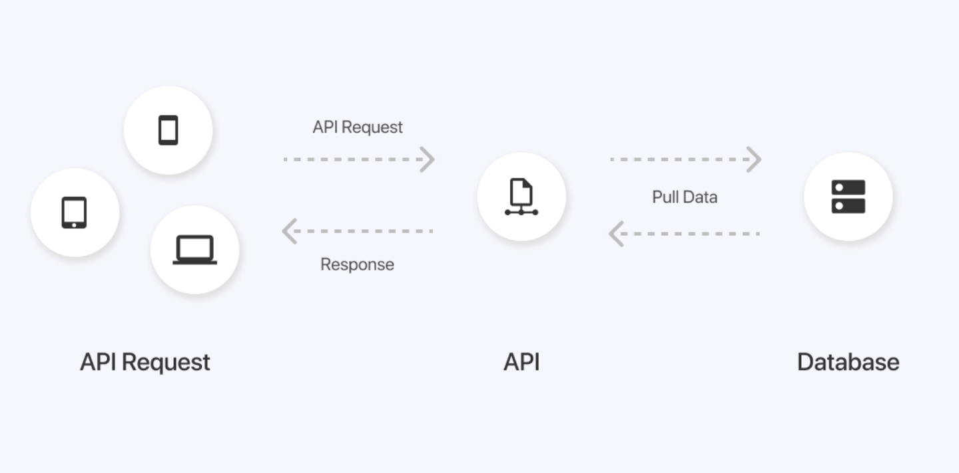
API
API (Application Programming Interface), is a software communication protocol that allows two applications to talk to each other.
3

Slide 7
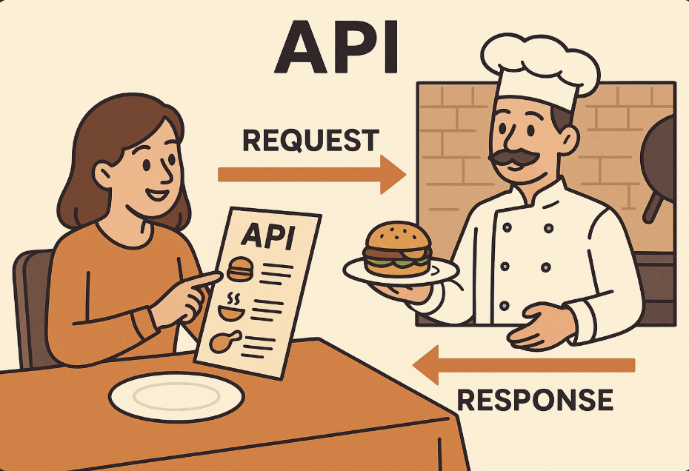
API
Think of an API like a restaurant menu. The menu provides a list of dishes you can order, along with a description of each. When you specify what you want, the kitchen (the system) prepares it and gives it to you. You don’t need to know how the kitchen prepares the food — you just use the menu to interact with it.
5

Slide 8
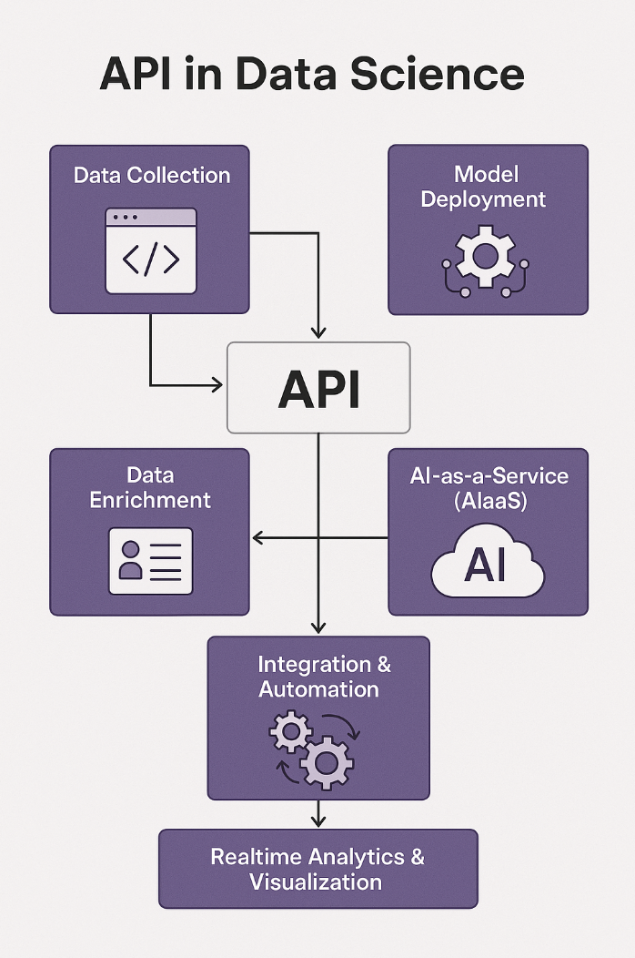
API
1. Connect to Open Data APIs
For example, Twitter, Facebook, Google Maps, OpenWeather, or financial APIs (Yahoo Finance, CoinMarketCap).
2. Data Enrichment
OpenAI API Key
3. Model Deployment
The problem of online lending at banks
5

Slide 9
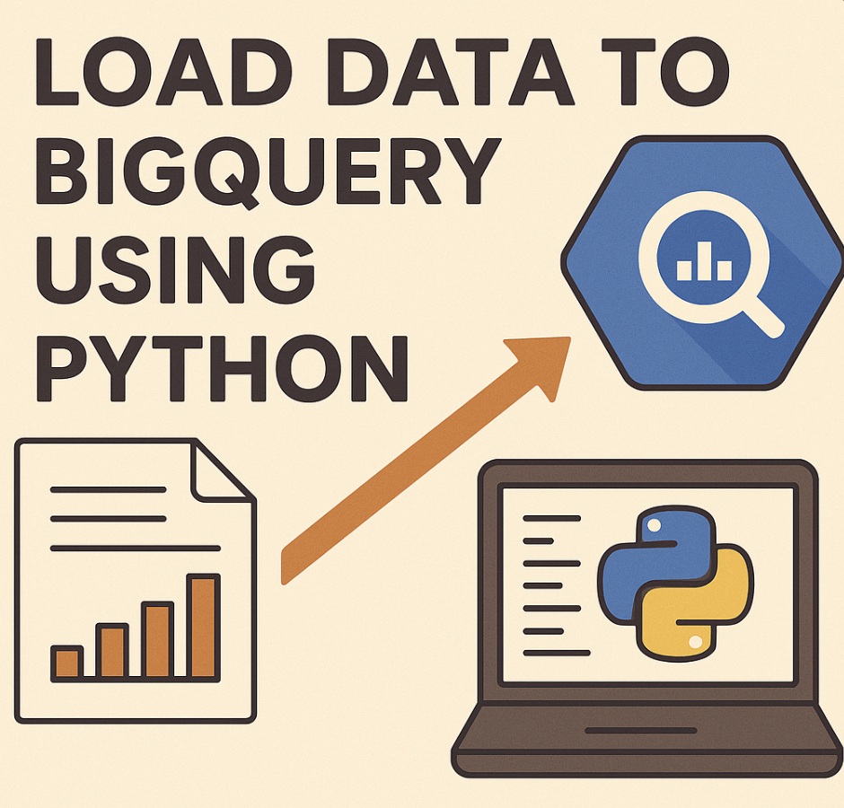
5

Slide 10
PRACTICES
4

Slide 11

fullstackdatascience.com
References
https://dataedo.com/samples/html/Data_warehouse/doc/AdventureWorksDW_4/home.html
11

Slide 12





Thank you
096 574 90 25
CREATED BY
Nguyen Tien Huy
info@robusto.ai
fullstackdatascience
huynt@fullstackdatascience.com
Data Manager
https://fullstackdatascience.com/
Hanoi, Vietnam

